Slide 1
Microcomputer Principles
&
Computer Interface
Lu Yin
luyin@nwpu.edu.cn

Slide 2
Chapter 3
Arithmetic and Logic Instructions and Programs
Contains
  Arithmetic of unsigned numbers
    Addition and subtraction instructions
    Multiplication and division instructions
  Bit operation
    Logical shift instructions
    Bitwise rotation instructions

Slide 3
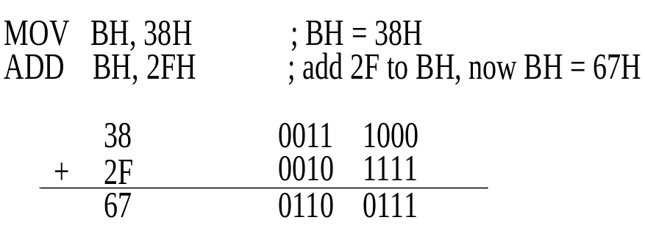
Section 3.1
Unsigned Addition and Subtraction
Quick review
  Assign data to destination places: MOV
    MOV dest, sour ;copy data from sor to dest
  Adds up unsigned data: ADD (Example 1-10)
    ADD dest, sour ;dest <= dest + sour
  CF = 0 since there is no carry beyond d7
  AF = 1 since there is carry from d3 to d4
  PF = 0 since there is an odd number of 1s in the result
  ZF = 0 since the result is not zero
  SF = 0 since d7 of the result is zero

Slide 4
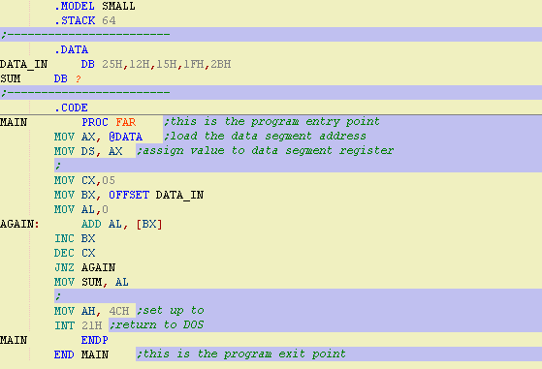
Section 3.1
Unsigned Addition and Subtraction
Adding 5 byte data (prog2-1.asm)

Slide 5
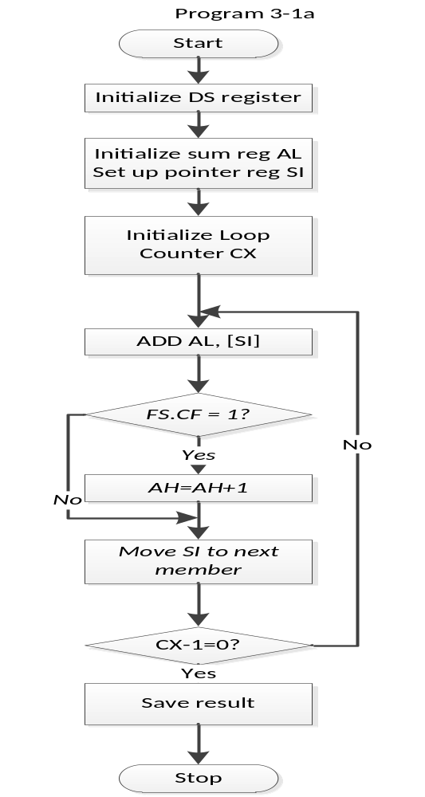
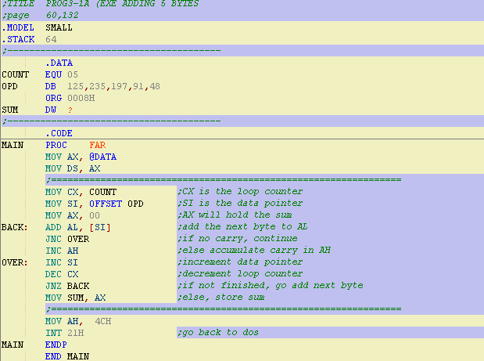
Section 3.1
Unsigned Addition and Subtraction

Slide 6
Section 3.1
Unsigned Addition and Subtraction
Analysis of Program 3-1a
  Data in the array:7D, 0EB, 0C5, 5B, 30 ➔ the summation will exceed 0FFH
  Iterations of the loop
    AL<=7D + 00, CF=0, AH=0, CX=04, ZF=0;
    (SI ++, and will points to EB): AL<= AL+EB=7D+EB, AL=68H & CF=1 ➔ AH=AH+1=1, CX=03,ZF=0;
    (SI++, and will points to C5): AL<=AL+C5=68+C5, AL=2D & CF=1 ➔ AH=AH+1=2, CX=02, ZF=0;
    …
    …

Slide 7
Section 3.1
Unsigned Addition and Subtraction
Differences between prog2-1 and prog3-1
  In 2-1, summation will not exceed 0FFH; while prog3-1a does;
  In 2-1, carry out on bit7 will not be considered; while prog3-1a should;
  The carry out will cause branches in prog3-1a, and the pipeline of the CPU has to be rebuild on line OVER
Q: is there another way to avoid pipeline rebuild?
  A: ADC instruction

Slide 8
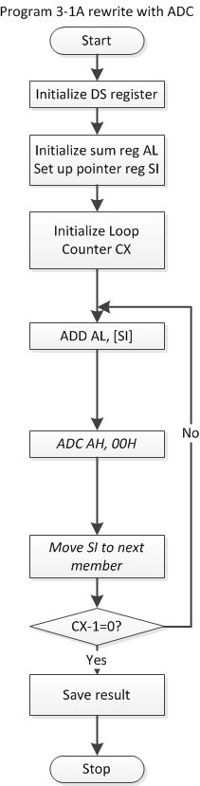
Section 3.1
Unsigned Addition and Subtraction
Adds up with carry from lower digit: ADC
  ADC dest, sour ; dest<=dest+sour+CF
Rewrite prog3-1a with the ADC instruction:
BACK: ADD AL, [SI] ;add the next byte to AL
JNC OVER ;see if there is a carry
INC AH ;if does, AH = AH + 1, adds up carry
OVER: INC SI ;increment data pointer
BACK: ADD AL, [SI] ;add the next byte to AL
ADC AH, 00 ;add 1 to AH if CF=1
INC SI ;increment data pointer

Slide 9
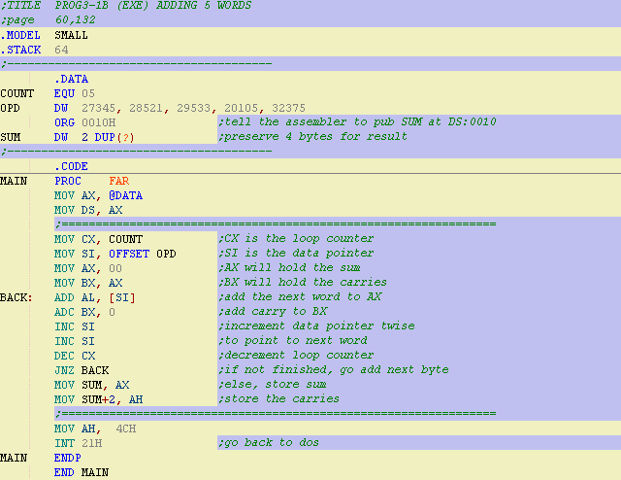
Section 3.1
Unsigned Addition and Subtraction
Word Addition: CF on bit15
ADD AX, WORD PTR[SI]

Slide 10
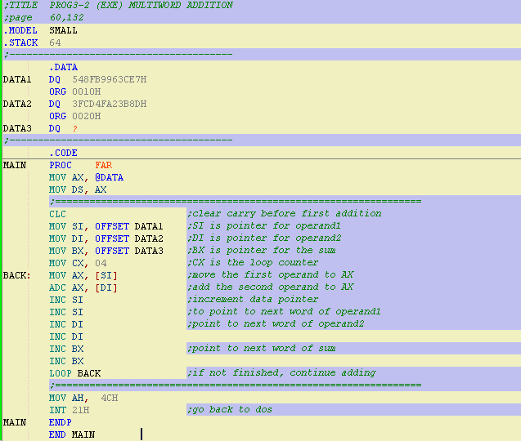
Section 3.1
Unsigned Addition and Subtraction
Addition of multiword numbers

Slide 11
Section 3.1
Unsigned Addition and Subtraction
Analysis of Program 3-2
  Addition of multiword is done by unit (fits to ALU size);
  CLC instruction: set FS.CF = 0
  Loop instruction:
    Usage:
      MOV CX, n
      LO_START: …
      LOOP LO_START
    effect:
      DEC CX, and JNZ LO_START
      The CF bit will be effected

Slide 12
Section 3.1
Unsigned Addition and Subtraction
Subtraction of unsigned numbers
  SUB dest, sour ;dest<=dest – sour
  Subtraction is done by 2’s complement addition;
2’s complement
  Number (n-bits) + 2’s complement = 2^{n}
  SUB dest, sour = ADD dest, sour’s 2’s complement

Slide 13
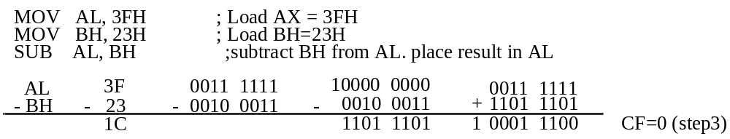
Section 3.1
Unsigned Addition and Subtraction
Example 3-2
  Show the steps involved in the following
  CF = 0, AF = 0, PF = 0, ZF = 0, SF = 0
  The programmer must look at the CF (but not the SF) to determine if the result is positive or negtive

Slide 14
Section 3.1
Unsigned Addition and Subtraction
The processor uses 2’s complement to do (unsigned) subtraction. The subtrahend is processed in hardware as follows:
  1. Take the 2’s complement of the subtrahend (source operand).
  2. Add it to the minuend ( destination operand).
  3. Invert the carry.

Slide 15
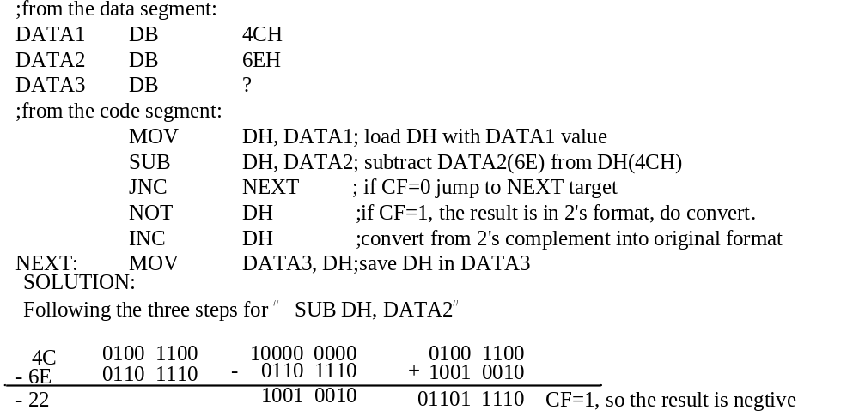
Section 3.1
Unsigned Addition and Subtraction
Example 3-3
  Analyze the following program

Slide 16
Section 3.1
Unsigned Addition and Subtraction
Do subtraction with borrow bit
  SBB instruction
    SBB will take care of the borrow of the lower operand.
    If the CF=0, SBB works like SUB.
    If the CF=1, SBB subtracts 1 from the result.
  Besides: PTR directive:
    Works as the “cast” operation of a pointer in C language;
    PTR data specifier directive is used specify the size of the operand when it differs from the defined size.
    Generally, when you are not so sure about data size processed in your instruction, use PTR!

Slide 17
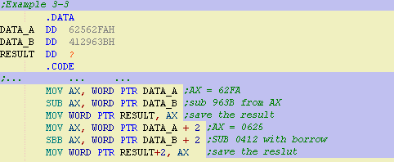
Section 3.1
Unsigned Addition and Subtraction
Example 3-3
  Analyze the following program
  After the SUB, AX=62FA-963B=CCBF and the carry flag is set.
  Since CF=1, when SBB is executed, AX=625-412-1=212.
  Therefore, the value stored in RESULT is 0212CCBF

Slide 18
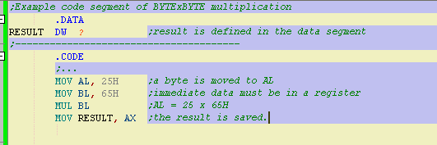
Section 3.2
Unsigned Multiplication and Division
Multiplication of unsigned numbers
  Byte X Byte
    1) Operand must be in the AL.
    2) The other operand can be other in reg or mem.
    3) The result goes to AX.

Slide 19
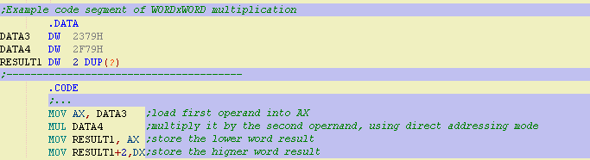
Section 3.2
Unsigned Multiplication and Division
Multiplication of unsigned numbers
  Word X Word
    1) Operand must be in the AX.
    2) The other operand can be other in reg or mem.
    3) The result goes to DX AX.

Slide 20
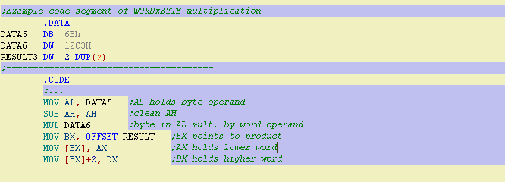
Section 3.2
Unsigned Multiplication and Division
Multiplication of unsigned numbers
  Word X Byte
    1) Byte operand must be in the AL.
    2) AH must be cleaned.
    3) The other operand can be other in reg or mem.
    4) The result goes to DX AX.

Slide 21
Section 3.2
Unsigned Multiplication and Division
Summery of Unsigned Multiplication
  Table3-1 unsigned multiplication summary
Multiplication | Operand1 | Operand2 | Result
Byte x Byte | AL | Reg/Mem | AX
Word x Word | AX | Reg/Mem | DX AX
Word x Byte | AL holds byte, AH=0 | Reg/Mem | DX AX

Slide 22
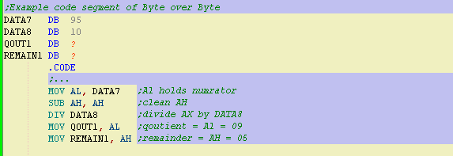
Section 3.2
Unsigned Multiplication and Division
Division of unsigned numbers
  Byte over Byte
    1) the numerator must be in the AL.
    2) AH must be cleaned.
    3) The denominator can not be immediate but can be in a reg or mem.
    4) The quotient goes to AL, and the remainder goes to AH

Slide 23
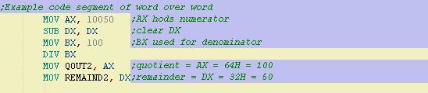
Section 3.2
Unsigned Multiplication and Division
Division of unsigned numbers
  Word over Word
    1) the numerator must be in the AX.
    2) DX must be cleaned.
    3) The denominator can not be immediate but can be in a reg or mem.
    4) The quotient goes to AX, and the remainder goes to DX.

Slide 24
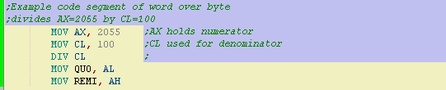
Section 3.2
Unsigned Multiplication and Division
Division of unsigned numbers
  Word over Byte
    1) the numerator must be in the AX.
    2) The denominator can not be immediate but can be in a reg or mem.
    3) The quotient goes to AL, and the remainder goes to AH.
    4) The max quotient is FFH

Slide 25
Section 3.2
Unsigned Multiplication and Division
Summery of Unsigned Division
  Table3-2 unsigned division summary
Multiplication | Operand1 | Operand2 | Quotient | Remainder
Byte / Byte | AL holds byte,AH=0 | Reg/Mem | AL¹ | AH
Word / Word | AX | Reg/Mem | AX² | DX
Word / Byte | AL holds byte, AH=0 | Reg/Mem | AL¹ | AH
  Notes:
  1. Divide error interrupt if AL>FFH.
  2. Divide error interrupt if AX>FFFFH

Slide 26
Section 3.3
Logic Instructions
AND instruction
  Format: AND destination, source
  Flags influenced:
    Clean CF, OF;
    Change PF, ZF, SF
  Usage:
    Mask certain bits;
    Test a zero operand
      AND BL, BL
      JZ go-label;

Slide 27
Section 3.3
Logic Instructions
OR instruction
  Format: OR destination, source
  Flags influenced:
    Clean CF, OF;
    Change PF, ZF, SF
  Usage:
    Set certain bits;
    Test a zero operand.
      OR BL, BL
      JZ go-label

Slide 28
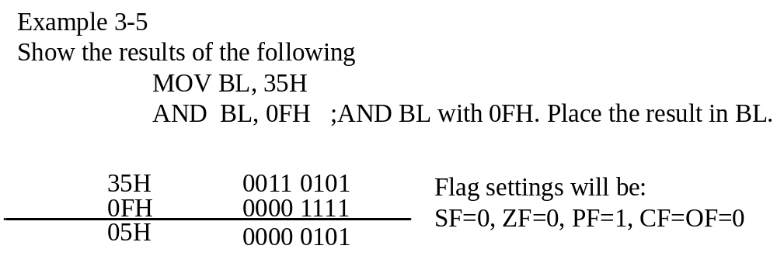
Section 3.3
Logic Instructions

Slide 29
Section 3.3
Logic Instructions
XOR instruction
  Format: XOR destination, source
  Flags influenced:
    Clean CF, OF;
    Change PF, ZF, SF
  Usage:
    Test if tow registers have the same value;
    Toggle bits of an operand.

Slide 30
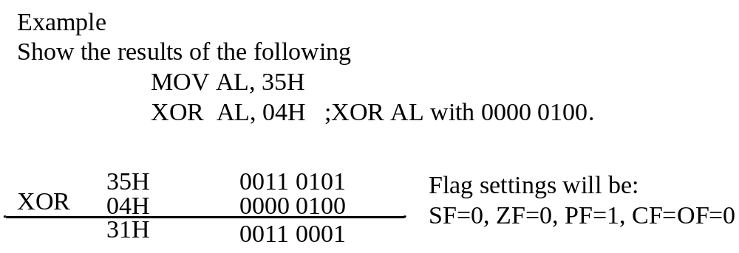
Section 3.3
Logic Instructions

Slide 31
Section 3.3
Logic Instructions
Logical shift for unsigned operands
  SHR: shift to right
    SHR AL ;shift to right by 1 bit
    SHR AL, CL ;shift to right many bits
    The LSB will go to the CF bit, and the MSB will be fit with 0
  SHL: shift to left
    SHL AL ;shift to left by 1 bit
    SHL AL, CL ;shift to left many bits
    The LSB will be fit with 0, and the MSB will go to the CF bit

Slide 32
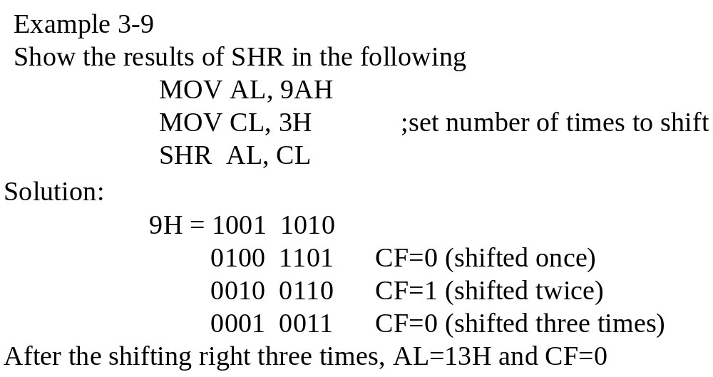
Section 3.3
Logic Instructions

Slide 33
Section 3.3
Logic Instructions
Compare of unsigned numbers
  CMP destination, source ;compare dest and src
  Only Flag Register will be changed. Both destination and source remain unchanged.
Table 3-3 flag settings for Compare Instruction
Compare operands | CF | ZF
Destination > source | 0 | 0
Destination = source | 0 | 1
Destination < source | 1 | 0

Slide 34
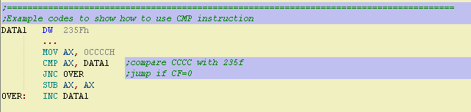
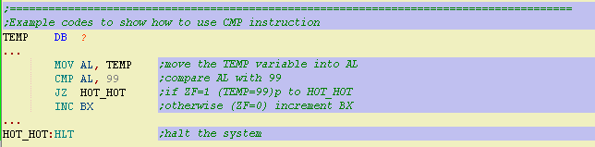
Section 3.3
Logic Instructions
Example of CMP instruction

Slide 35
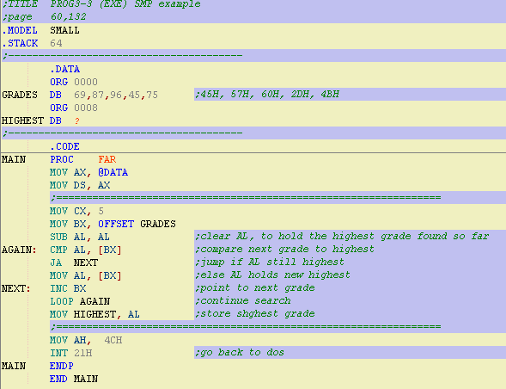
Section 3.3
Logic Instructions

Slide 36
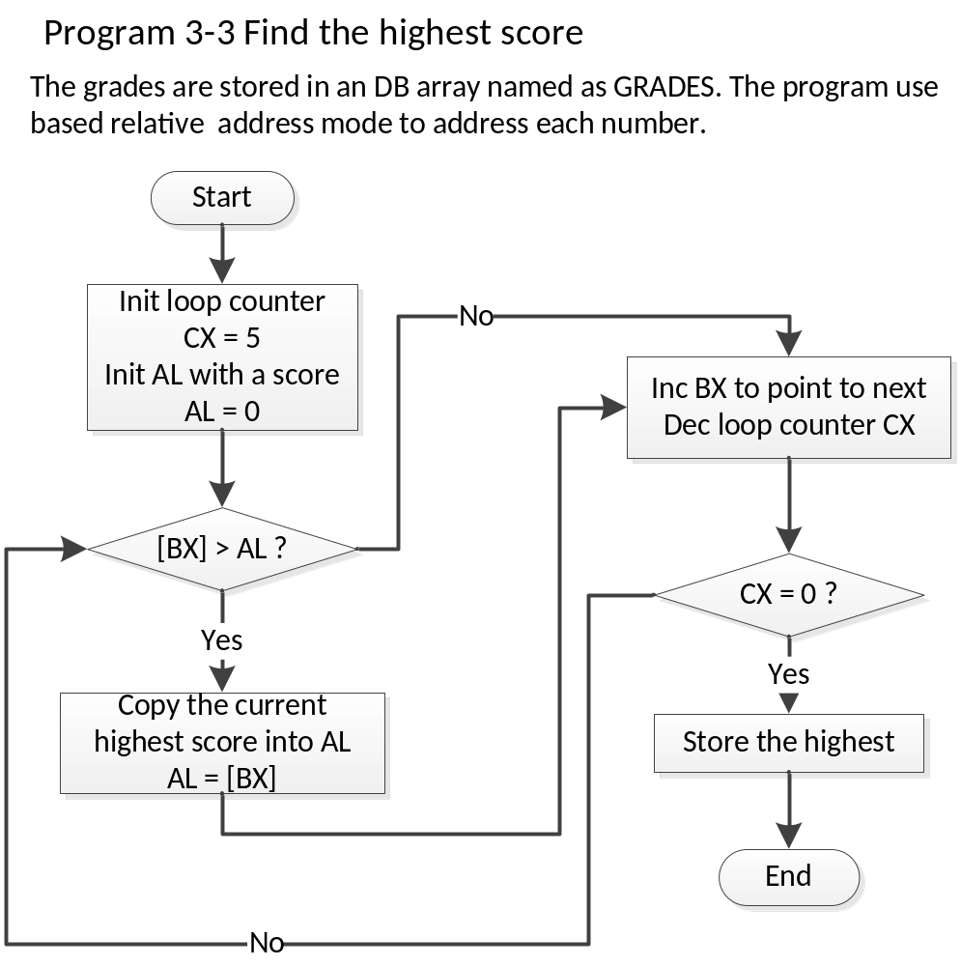

Slide 37
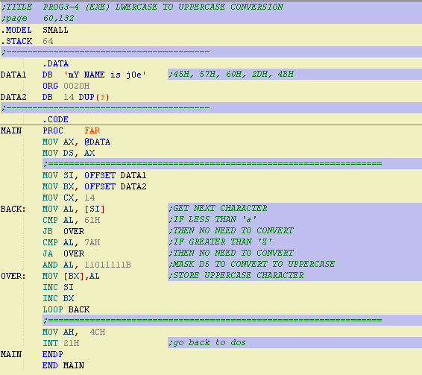
Section 3.3
Logic Instructions

Slide 38
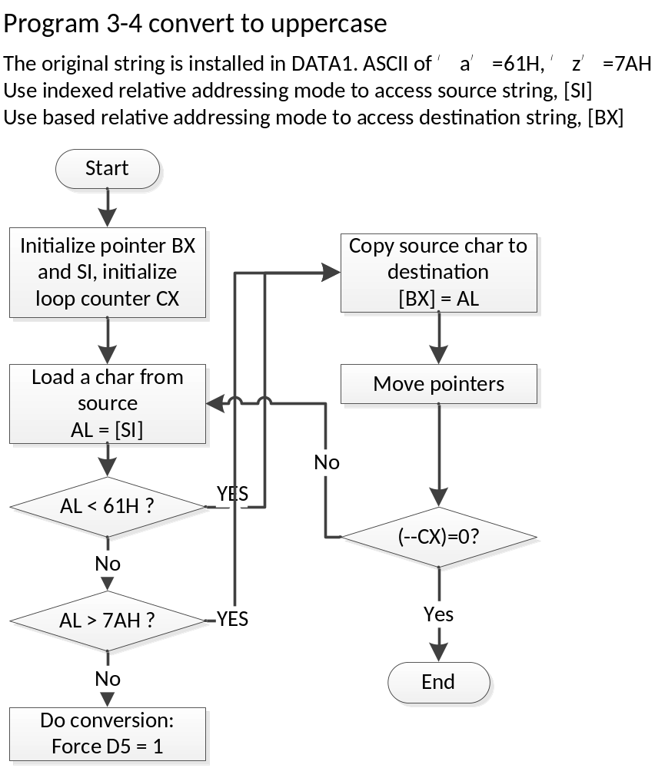

Slide 39
Section 3.4
BCD and ASCII conversion
BCD (Binary code Decimal) : Binary representation of 0 to 9 is called BCD;
Tow terms for BCD numbers:
  Unpacked BCD: only the lower 4 bits are used, and the upper 4 bits are kept 0;
  Packed BCD: Two BCD number are packed into a single byte. One in the lower 4 bits, and one in the upper 4 bits.
BCD:
0000 0010
0000 0100
=
DEC:
42
BCD:
0101 1001
DEC:
= 59

Slide 40
Section 3.4
BCD and ASCII conversion
ASCII numbers
  ASCII number is the key coding of a number character ( ‘0’ to ‘9’)
  Unpacked BCD number is used for ASCII number
  For example:
    When we press the ‘0’ key, coding “0011 0000” is provided to the computer by the keyboard.

Slide 41
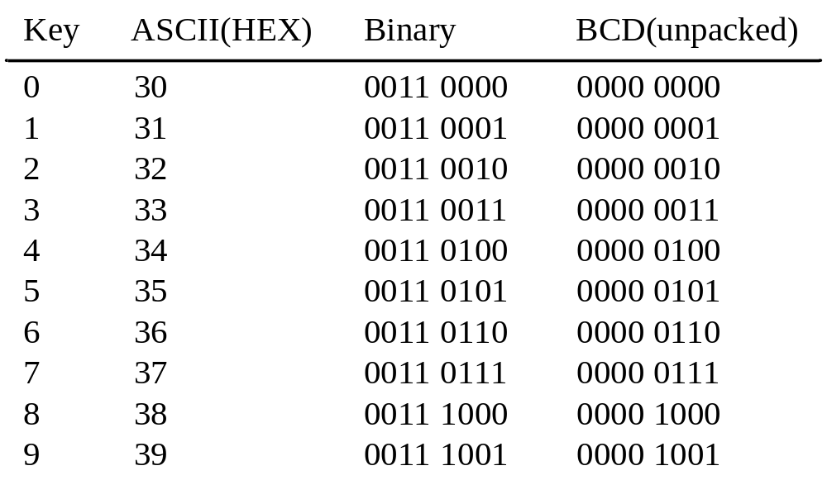
Section 3.4
BCD and ASCII conversion

Slide 42
Section 3.4
BCD and ASCII conversion
ASCII to BCD conversion
  Why should convert ASCII to BCD?
    Keyboard and Video card use ASCII coding system;
    The computer can convert ASCII into BCD and do calculation in BCD;
  How to convert ASCII into BCD?
    ASCII character → unpacked BCD - - > packed BCD

Slide 43
Section 3.4
BCD and ASCII conversion
ASCII to unpacked BCD conversion
  Mask off the higher 4bits.
  For example:
  The ASCII code of ‘4’ is 0011 0100B
  And the value of ‘4’ is 0000 0100B
  If we AND the ASCII code with 0000 1111B then
  The ASCII code of numbers will be converted to unpacked BCD numbers
  0011 0100B
  AND 0000 1111B
  ----------------------------
  0000 0100B

Slide 44
Section 3.4
BCD and ASCII conversion
;Example 3-5a convert ASCII number'9562481273' to unpacked BCD
.DATA
ASC DB '9562481273'
ORG 0010H
UNPACK DB 10 DUP(?)
.CODE
...
MOV CX, 5
MOV BX, OFFSET ASC ;BX points to ASCII data
MOV DI, OFFSET UNPACK ;DI points to unpacked BCD data
AGAIN: MOV AX, [BX] ;move next 2 ASCII numbers to AX
AND AX, 0F0FH ;remove ASCII 3s
MOV [DI], AX ;store unpacked BCD
ADD DI, 2 ;point to next unpacked BCD data
ADD BX, 2 ;point to next ASCII data
LOOP AGAIN
…

Slide 45
Section 3.4
BCD and ASCII conversion
;Example 3-5c convert ASCII number'9562481273' to unpacked BCD
.DATA
ASC DB '9562481273'
ORG 0010H
UNPACK DB 10 DUP(?)
.CODE
...
MOV CX, 10 ;load the counter
SUB BX, BX ;clear BX
AGAIN: MOV AL, ASC[BX] ;move tu AL conten of mem [BX+ASC]
;(here we use Based relative addressing mode)
AND AL, 0FH ;mask the upper nibble
MOV UNPACK[BX] ;move to mem [BX+UNPACK] the AL
INC BX ;point to next byte
LOOP AGAIN ;loop until it is finished

Slide 46
Section 3.4
BCD and ASCII conversion
ASCII to packed BCD
  Convert to unpacked BCD
  Combine each 2 unpacked BCD to 1 packed BCD
  KEY ASCII unpacked BCD packed BCD
  4 34 0000 0100
  7 37 0000 0111 0100 0111 or 47H
  .DATA
  ORG 0010H
  VAL_ASC DB '47'
  VAL_BCD DB ?
  ;reminder: DB will put 34 in 0010H location and 37 in 0011H
  .CODE
  MOV AX, WORE PTR VAL_ASC ;AH=37,AL=34
  AND AX, 0F0FH ;convert to unpacked BCD
  XCHG AH, AL ;swap AH and AL
  MOV CL, 4
  SHL AH,CL ;shift left AH to get AH=40H
  OR AL,AH
  MOV VAL_BCD, AL
This is the format we want
0011 0111
0011 0100
0000 0111
0000 0100
0000 0100
0000 0111
0100 000
0000 0111
0100 000
0100 0111

Slide 47
Section 3.4
BCD and ASCII conversion
Packed BCD to ASCII conversion
  Packed BCD to unpacked BCD
    Use SHL / SHR to make all digits right
    Use AND to mask off the higher digits
  Unpacked BCD to ASCII
    Use OR to convert higher parts to ‘0011’

Slide 48
Section 3.4
BCD and ASCII conversion
BCD addition and correction
  Input 2 BCD operands:
    MOV AL, 17H ;(17 in decimal)
    MOV BL, 28H ;(28 in decimal)
  The addition is done by Hexadecimal
    ADD AL, BL ;we have 3FH in AL, but not 45 in BCD
  How to convert the result to BCD automatically?
    For a carry in Hexadecimal means 16 in decimal, so we can add up 6 (0110B) to 3FH to force a carry from the lower part.
    Intel implements the DAA instruction will do it for us.

Slide 49
Section 3.4
BCD and ASCII conversion
DAA instruction
.DATA
DATA1 DB 17H ;BCD number, 17 in decimal
DATA2 DB 28H ;BCD number, 28 in decimal
DATA3 DB ?
.CODE
MOV AL, DATA1
MOV BL, DATA2
ADD AL, BL ;BCD addition
DAA ;adjust for BCD addition
MOV DATA3, AL ;store the result (in packed BCD mode)
0001 0111
0010 1000
0001 0111
F>9. AF=0
0011 1111
+ 0110
0100 0101

Slide 50
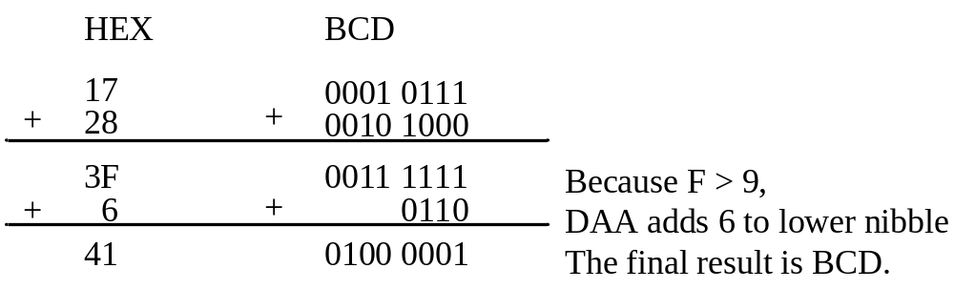
Section 3.4
BCD and ASCII conversion
Summary of DAA action
  1. If after an ADD or ADC instruction the lower nibble (4bits) is greater than 9, or if AF is set to 1, add 0110B to the lower 4 bits;
  2. If the upper nibble is greater than 9, or if CF is set to 1, add 0110B to the upper nibble.

Slide 51
Section 3.4
BCD and ASCII conversion
Limitation in using DAA instruction
  1. DAA works only with AL;
  2. DAA use AF to decide whether do correction;
  3. DAA must be used after the addition of BCD operands. That is to say, no digits in the operands can exceed 9;
  4. DAA must follows ADD or ADC. It will do nothing after INC.

Slide 52
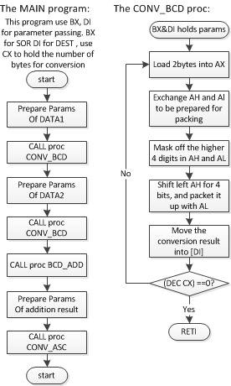
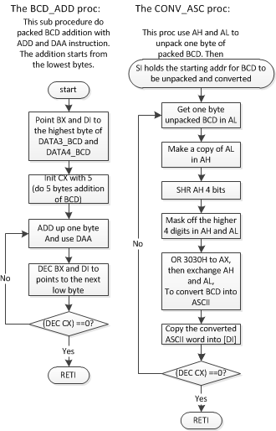

Slide 53
Section 3.4
BCD and ASCII conversion
BCD subtraction and correction
  Use DAS instruction to correct the result.
Summary of DAS action
  1. If after a SUB or SBB instruction the lower nibble is greater than 9, or if AF=1, subtract 0110 from the lower 4 bits;
  2. If the upper nibble is greater than 9, or CF=1, subtract 0110 from the upper nibble.

Slide 54
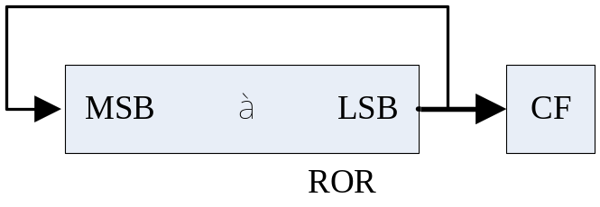
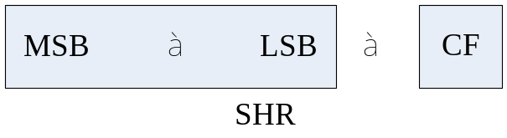
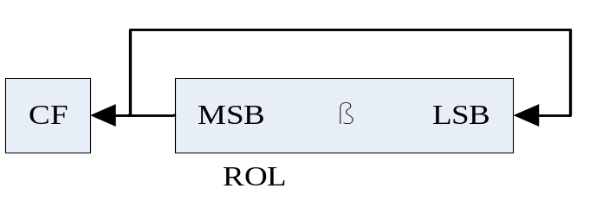
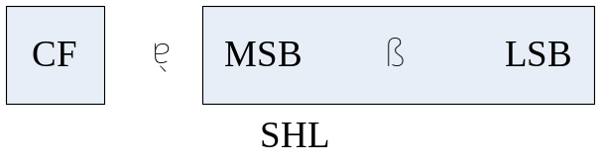
Section 3.5
Rotate Instructions
Quick Review
  Logical Shifting
Rotating
  Rotate without CF bit

Slide 55
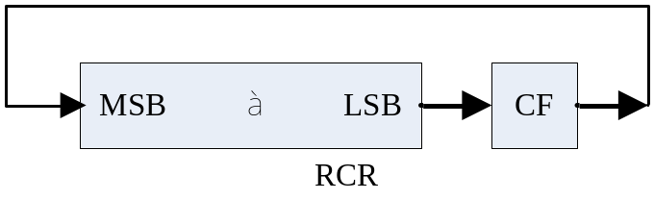
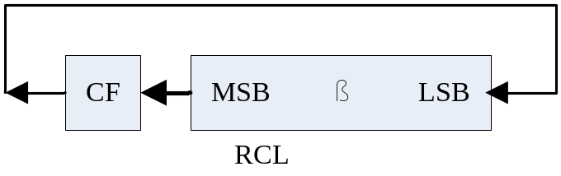
Section 3.5
Rotate Instructions
Rotating
  Rotate through CF bit

Slide 56
Section 3.6
Bitwise Operation in the C Language
Logical arithmetic in C
  AND(&&), OR(||), NOT(!)
Bitwise operators in C
  AND(&), OR(|), INVERT(~), EX_OR(^)
  SHR(>>), SHL(<<)

Slide 57
Section 3.6
Bitwise Operation in the C Language
Packed BCD to ASCII conversion in C
  Do it with bitwise operators
  The algorithm is the same as in prog3-6.

Slide 58
Section 3.6
Bitwise Operation in the C Language
//Program 3-10: convert packed BCD to ASCII
#include <stdio.h>
main()
{
unsigned char mybcd=0x29; //declear a BCD number in hex
unsigned char asci_1;
unsigned char asci_2;
asci_1 = mybcd & 0x0f; //mask the upper four bits
asci_1 = asci_1 | 0x30; //make it an ASCII char
asci_2 = mubcd & 0xf0; //mask the lower four bits
asci_2 = asci_2 >> 4; //shift to lower four bits
asci_2 = asci_2 | 0x30 //make it an ASCII char
printf("BCD data %X is %c, %c in ASCII\n", mybcd, asci_1, asci_2);
printf("My BCD data is %c if not converted to ASCII\n", mybcd);
}

Slide 59
Chapter 3
Exercises:
  Section 1: Problem 1
  Section 2: None
  Section 3: Problem 9
  Section 4: Problem 14
  Section 5: Problem 21
  Section 6: None

